Slide 1
Ap computer science unit 2
Teacher: Iddo Sadeh

Slide 2
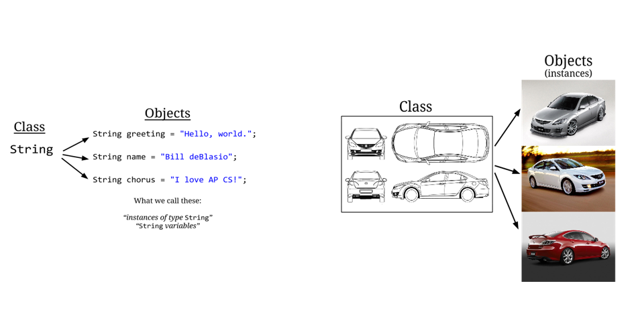
Class and objects
*taken from Teals program
Notes:
Class classifies a type and what objects (data/ type) of that type do
https://runestone.academy/runestone/books/published/apcsareview/JavaBasics/introClassObject.html
Example of creating class
https://runestone.academy/runestone/books/published/apcsareview/JavaBasics/firstOOClass.html

Slide 3
Class example
https://runestone.academy/runestone/books/published/apcsareview/JavaBasics/firstOOClass.html

Slide 4
Parts of java class
https://runestone.academy/runestone/books/published/apcsareview/JavaBasics/partsOfAClass.html
Notes:
Go over link and ask students to start lab

Slide 5
Key notes on classes and objects
Overloading Constructors - There can be more than one constructor defined in a class. This is called overloading the constructor.
Procedural abstraction - a programmer can use a method and not worry about the details of how it exactly works.
Tracing methods – it is key to be able to understand methods already cretaed
Notes:
We can use a constructor like we saw in the previous example or a default constructor with no values called a no-argument constructor.
We will introduce ourselves to the string and math class in this lesson.
Tracing methods https://csawesome.runestone.academy/runestone/books/published/csawesome/Unit2-Using-Objects/topic-2-4-methods-with-params.html

Slide 6
String class

Slide 7
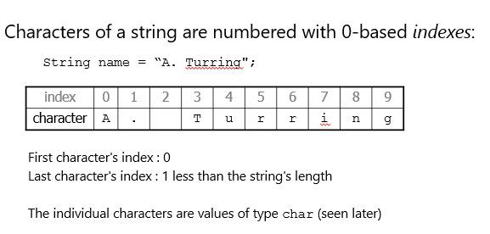
indexes
*taken from Teals program

Slide 8
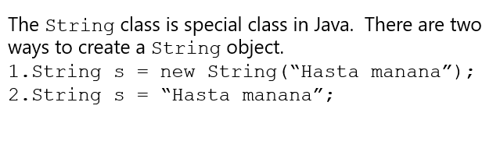
String constructor
*taken from Teals program

Slide 9
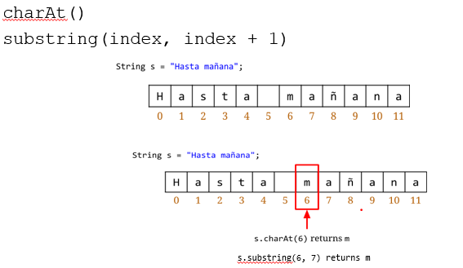
Single Character string processing
*taken from Teals program

Slide 10
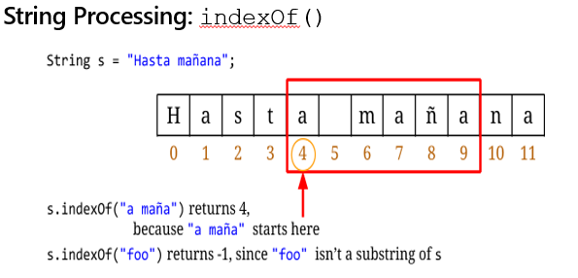
Searching your string
*taken from Teals program

Slide 11
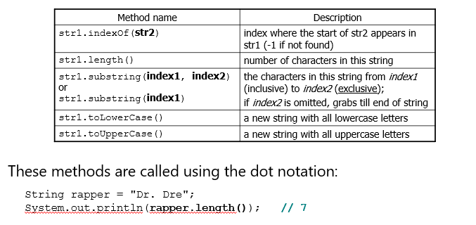
String methods
*taken from Teals program

Slide 12
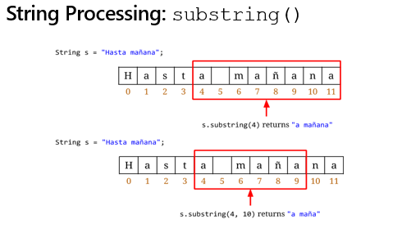
substring
*taken from Teals program

Slide 13
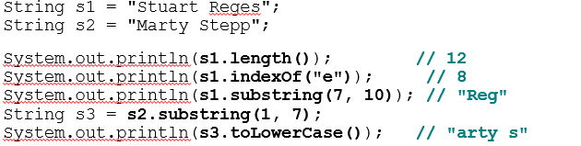
String method examples
*taken from Teals program

Slide 14
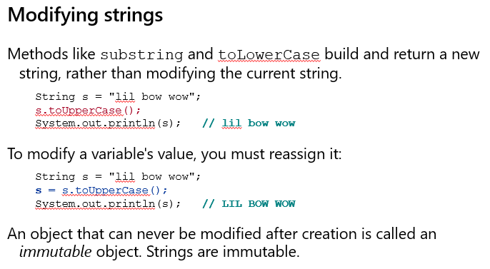
Modifying strings
*taken from Teals program

Slide 15
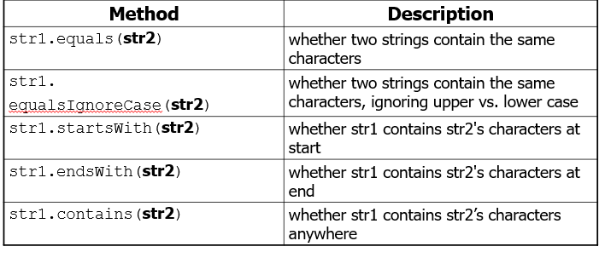
String test methods
*taken from Teals program

Slide 16
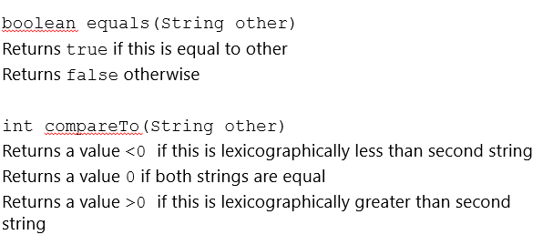
comparisons
*taken from Teals program

Slide 17
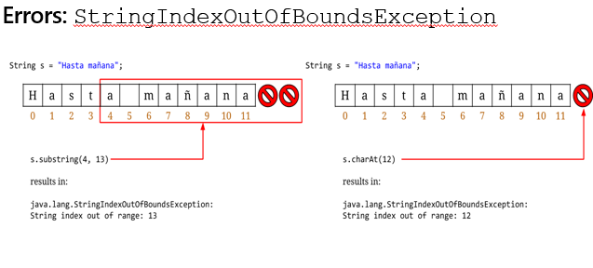
Out of bound indexes
*taken from Teals program

Slide 18
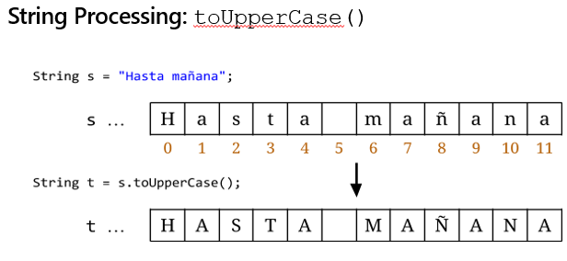
Capitalizing your string
*taken from Teals program
*taken from Teals program

Slide 19
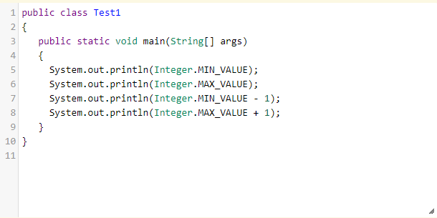
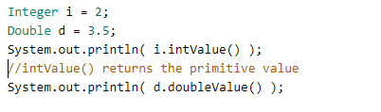
Wrapper Classes – int and bouble
For every primitive type in Java, there is a built-in object type called a wrapper class
The wrapper class for int is called Integer, and for double it is called Double.
* Code taken from CSAwesome texbook
Notes:
Integer / Double

Slide 20
Math CLass

Slide 21
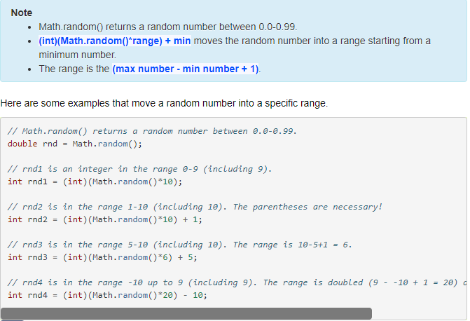

Math.random
Notes:
Static methods (also called class methods) are called using the class name and the dot operator (.) followed by the method name. You do not need to create an object of the class to use them. You can use ClassName.methodName() or just methodName() if they are called from within the same class.
https://www.geeksforgeeks.org/static-methods-vs-instance-methods-java/

Slide 22
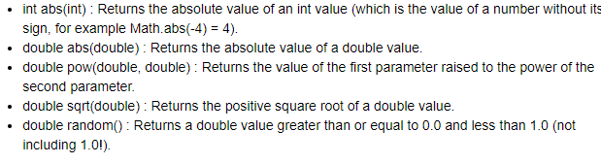
More math methods

